Slide 1
Business Data Communications
Fourteenth Edition
Jerry FitzGerald, Alan Dennis, and Alexandra Durcikova
Chapter 7
Wired and Wireless Local Area Networks

Slide 2
Learning Objectives
Discuss the main components of LANs.
Discuss the best practice recommendations for LAN design.
Design wired Ethernet LANs.
Design wireless Ethernet LANs.
Explain how LAN performance can be improved.

Slide 3
7.1 Introduction
Most large organizations have numerous wired and wireless LANs connected by backbone networks.
We discuss the fundamental components of a LAN, along with two technologies commonly used in LANs: traditional wired and wireless Ethernet.

Slide 4
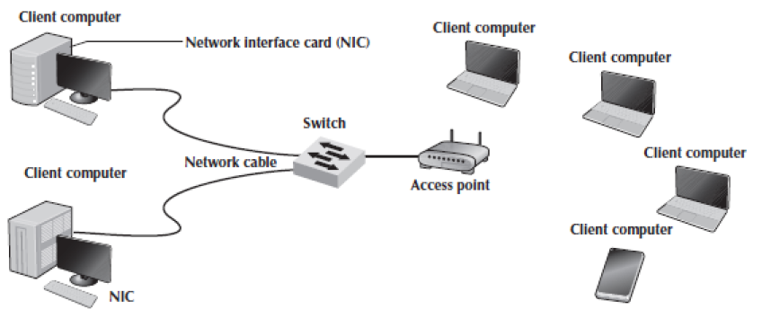
7.2 LAN Components
Client computer (Chapter 2)
Server (Chapter2)
Network interface cards (NICs)
Network circuits
Hubs/switches/access points
The network operating system

Slide 5
Network Interface Cards
The network interface card (NIC) is used to connect the computer to the network cable in a wired network.
In a wireless network, the NIC is a radio transceiver that sends and receives messages on a specific radio frequency.
All desktop computers have a wired NIC built in.
Virtually all laptops have both a wired NIC and a wireless NIC.

Slide 6
Network Circuits
Most LANs are built with unshielded twisted-pair (UTP) cable, shielded twisted-pair (STP) cable, or fiber-optic cable.
Many LANs use UTP cable.
STP is only used in special areas that produce electrical interference.
Fiber-optic cable is even thinner than UTP wire and therefore takes far less space when cabled throughout a building.

Slide 7
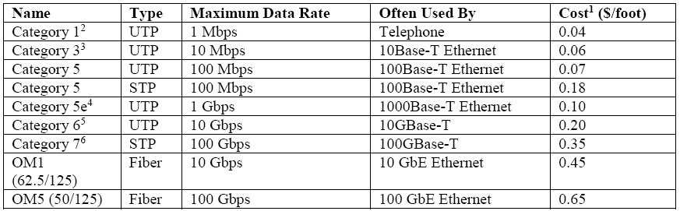
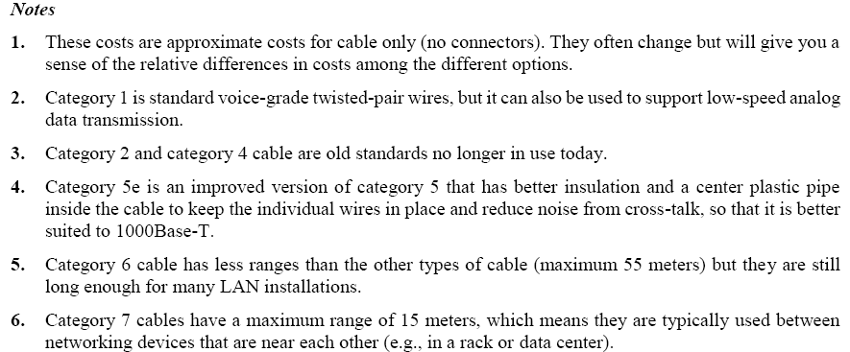
Commonly Used Network Cable Standards

Slide 8
Wireless LANs (WLANs)
Wireless LANs (WLANs) use radio transmissions to send data between the NIC and the access point (AP).
Most countries (but not all) permit WLANs to operate in two frequency ranges: the 2.4- and 5 GHz range.
May interfere with cordless phones and baby monitors.
Under ideal conditions, the radio transmitters in the NICs and APs can transmit 100–150 meters.
As the distance from the AP increases, the maximum speed drops.
When we design a WLAN, it is important to ensure that the APs don’t interfere with each other.
Therefore, each AP is set to transmit on a different channel.

Slide 9
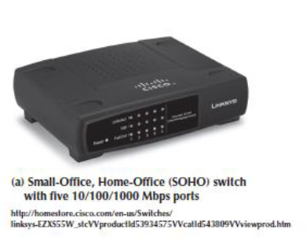
Network Hubs, Switches, and Access Points
Network hubs and switches serve two purposes
They provide an easy way to connect network cables.
They act as repeaters
They can be thought of as a junction box, permitting new computers to be connected to the network.
Each connection point where a cable can be plugged in is called a port
Each port has a unique number

Slide 10
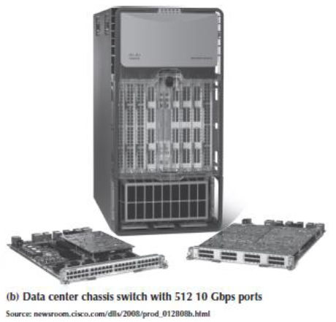
Network Hubs, Switches, and Access Points Continued
Signals can travel only so far in a network cable before they attenuate.
Hubs and switches act as repeaters
A wireless access point (AP) is a radio transceiver that plays the same role as a hub or switch in wired Ethernet LANs.
Most WLANs are installed using APs that have omnidirectional antennas.

Slide 11
QUIZ 1
The Network Interface Card (NIC) permits a computer to be physically connected to a network’s cable. (TRUE/FALSE)?.
Ans: TRUE

Slide 12
QUIZ 2
Many network hubs and switches incorporate repeaters to regenerate signals so that attenuation of the signal does not occur. (TRUE/FALSE)?
Ans: TRUE

Slide 13
Network Operating Systems
The network operating system (NOS) is the software that controls the network
Every NOS provides two sets of software
One that runs on the network server(s)
One that runs on the network client(s)
The server version of the NOS provides the software that performs the functions associated with the data link, network, and application layers and usually the computer’s own operating system.
The client version of the NOS provides the software that performs the functions associated with the data link and the network layers and must interact with the application software and the computer’s own operating system.

Slide 14
NOS Server Software
The NOS server software enables the file server, print server, or database server to operate.
It acts as the application software by executing the requests sent to it by the clients.
NOS server software replaces the normal operating system on the server.

Slide 15
NOS Client Software
The NOS software running at the client computers provides the data link layer and network layer.
Windows provides built-in software that will enable it to act as a client computer with a Windows Server.

Slide 16
Network Operating Systems Continued
One of the most important functions of a NOS is a directory service
They provide information about resources on the network that are available to the users.
A common example of directory services is Microsoft’s Active Directory Service (ADS).
ADS works in much the same manner as TCP/IP’s DNS service.

Slide 17
Network Profiles
A network profile specifies what resources on each server are available on the network for use by other computers and which devices or people are allowed what access to the network.
It is normally configured when the network is established and remains in place until someone makes a change.
There must also be a user profile for each person who uses the LAN.

Slide 18
QUIZ 3
The NOS software for the server computer provides the physical, data link, and network layer functions. (TRUE/FALSE)?.
Ans: FALSE

Slide 19
QUIZ 4
Network profile refers to what resources on each server are available on the network for use by other computers and which devices or people are allowed access on the network. (TRUE/FALSE)?
Ans: TRUE

Slide 20
7.3 Wired Ethernet
Almost all LANs installed today use some form of Ethernet
It is a standard formalized by the IEEE as IEEE 802.3
Ethernet is a layer 2 protocol
Operates at the data link layer.
Every Ethernet LAN needs hardware at layer 1.

Slide 21
Topology
Topology is the basic geometric layout of the network
A logical topology is how the network works conceptually
A physical topology is how .the network is physically installed.

Slide 22
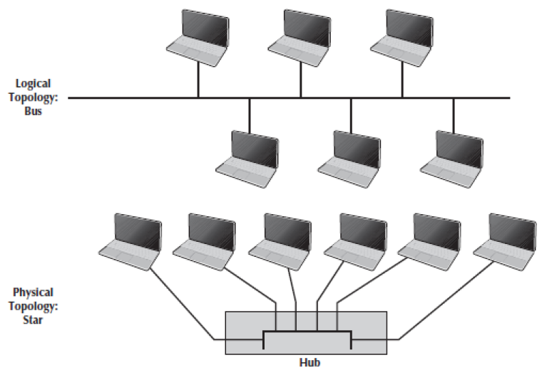
Hub-Based Ethernet
Hub-based Ethernet is seldom used by companies today
Cheap consumer-grade hubs are still available
When we use hubs, Ethernet’s logical topology is a bus topology
All frames from any computer flow to all computers on the LAN
Each computer only processes those frames addressed to it
This shared multipoint circuit is often called a collision domain

Slide 23
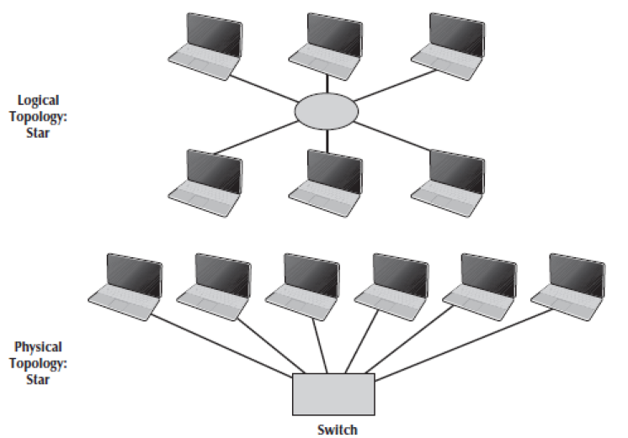
Switch-Based Ethernet
Almost all corporate installations of Ethernet today use switches
Used this way, Ethernet’s topology is a logical star and a physical star.
Each circuit connected to a switch is not shared with any other devices.
When a switch receives a frame, it looks at the address and retransmits the frame only on the circuit connected to that computer.

Slide 24
Switch-Based Ethernet Continued
To know which circuit to use, the switch uses a forwarding table that is very similar a routing table
Called a layer 2 switch
Switches learn addresses to build the forwarding table.
If a switch receives a frame with a destination address that is not in the forwarding table, must send to all ports
When the correct computer responds, it is added to the forwarding table.

Slide 25
Media Access Control(MAC)
When several computers share the same collision domain it is important to control their access to the media.
Collisions must be prevented or recovered from
This is called media access control
Ethernet uses a contention-based media access control technique called Carrier Sense Multiple Access with Collision Detection (CSMA/CD)
Wait until the circuit is free and then transmit
The solution to collisions is to this is to listen while transmitting, better known as collision detection (CD).
If the NIC detects a signal, it sends a jamming signal.

Slide 26
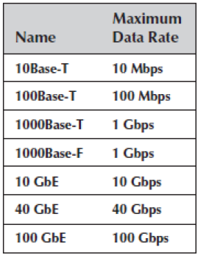
Types of Ethernet

Slide 27
QUIZ 5
A switch always broadcasts all the packets it receives to all the computers that are connected to the switch. (TRUE/FALSE)?.
Ans: FALSE

Slide 28
QUIZ 6
A forwarding table tells a switch which port it should send out a packet to get to the destination computer. (TRUE/FALSE)?
Ans: TRUE

Slide 29
7.4 Wireless Ethernet
Wireless Ethernet is the commercial name for a set of standards developed by the IEEE 802.11 standards group
commonly called Wi-Fi
The 802.11 family of technologies is much like the Ethernet family
The logical and physical topologies of Wi-Fi are the same as those of hub-based Ethernet: a physical star and a logical bus.

Slide 30
Wireless Media Access Control
Media access control in Wi-Fi is Carrier Sense Multiple Access with Collision Avoidance (CSMA/CA)
Similar to Ethernet
Detecting collisions is more difficult in radio transmission so Wi-Fi attempts to avoid collisions to a greater extent than traditional Ethernet.
Before a computer can transmit in a WLAN, it must first establish an association with a specific AP.

Slide 31
Associating with an AP
Searching for an available AP is called scanning.
An NIC can engage in either active or passive scanning.
During active scanning, a NIC transmits a special frame called probe frame on all active channels on its frequency range.
During passive scanning, the NIC listens on all channels for a special frame called a beacon frame that is sent out by an AP.

Slide 32
Distributed Coordination Function
The first media access control method is the distributed coordination function (DCF)
Also called physical carrier sense method
With DCF, each frame in CSMA/CA is sent using stop-and-wait ARQ
After the sender transmits one frame, it immediately stops and waits for an ACK from the receiver before attempting to send another frame.
The time interval between a frame and the matching ACK is so short that no other computer has the opportunity to begin transmitting.

Slide 33
Point Coordination Function
The second media access control technique is called the point coordination function (PCF)
Also called the virtual carrier sense method
Computers far away may t sense the other transmission and transmit at the same time causing a collision at the AP.
This is called the hidden node problem
In this case, the AP is the only device guaranteed to be able to communicate with all computers on the WLAN.
Therefore, the AP must manage the shared circuit using a controlled-access technique, not the contention-based approach of traditional Ethernet.

Slide 34
Point Coordination Function Continued
Any computer wishing to transmit first sends a request to send (RTS) to the AP.
If no other computer is transmitting, the AP responds with a clear to send (CTS), specifying the amount of time for which the circuit is reserved for the requesting computer.
Controlled-access methods provide poorer performance in low-traffic networks.
Controlled-access techniques work better in high-traffic WLANs.

Slide 35
Wireless Ethernet Frame Layout

Slide 36
Types of Wireless Ethernet
802.11n is an obsolete version, but many organizations continue to use it because it is cheap
Under perfect conditions, it provides three channels of 450 Mbps each with a maximum range of 100 meters
802.11ac is the current version
Runs in two frequency spectrums simultaneously to provide high speed data rates
There are several different versions of the standard, and vendors can choose what aspects to implement
One important innovation is that the RTS/CTS media access control is sent on a separate frequency range, so that it does not interfere with data transmission
802.11ax is the newest version (called Wi-Fi 6)
Runs in three different frequency spectrums to provide very high-speed data rates.

Slide 37
Security
Security it is especially important for wireless networks.
With a WLAN, anyone walking or driving within the range of an AP can begin to use the network.
One older wireless security technique is Wired Equivalent Privacy (WEP)
The AP requires the user to have a key to communicate with it
The WEP keys are produced dynamically.
New users must log in to receive a key.
WEP has a number of serious weaknesses.
Most experts agree that a determined hacker can break into a WLAN that uses only WEP security.

Slide 38
Security Continued
Wi-Fi Protected Access (WPA)
WPA is a newer, more secure type of security
WPA works in ways similar to WEP
The difference is that the WPA key is longer than the WEP key
More importantly, the key is changed for every frame that is transmitted to the client
802.11i (also called WPA2)
The newest, most secure type of WLAN security
The user logs in to a login server to obtain the master key
Uses the Advanced Encryption Standard (AES)
MAC address filtering
The AP only processes frames sent by computers whose MAC address is in the address list
This provides no security against a determined hacker.

Slide 39
7.5 The Best Practice LAN Design
Wi-Fi is considerably cheaper than wired Ethernet.
The largest cost of LANs is paying someone to install the cables.
Most organizations today install wired Ethernet to provide access for desktop users and install Wi-Fi as overlay networks.
They build the usual switched Ethernet networks as the primary LAN, but they also install Wi-Fi for laptops and mobile devices.

Slide 40
Managed APs
Most large companies install managed APs.
Managed APs are wired into a Wi-Fi Controller
They report what devices are attached to them and how busy they are to the controller.
If a laptop connects to a very busy AP when there are less busy APs nearby, the controller will instruct the AP to deny access to the laptop and the laptop will automatically try to connect to the next AP it sees.

Slide 41
Designing the Data Center
The data center is where the organization houses its primary servers
In most large organizations, the data center is huge.
Designing the data center requires considerable expertise
Servers are placed together in server farms or clusters.

Slide 42
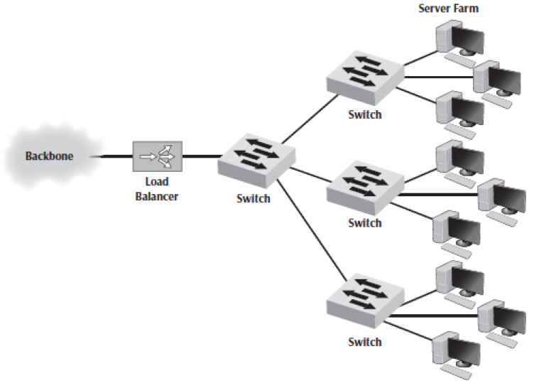
Designing the Data Center Continued
A special device called a load balancer or load balancing switch acts as a router at the front of the server farm.
When a request hits the load balancer, it forwards it to one specific server.
If a server crashes, the load balancer stops sending requests to it, and the network continues to operate.

Slide 43
7.6 Improving LAN Performance
To improve performance, you must locate the bottleneck, the part of the network that is restricting the data flow
Generally, either the network server or a network circuit
The first step in improving performance, therefore, is to identify whether the bottleneck lies in a circuit or the server.
Most organizations focus on ways to improve the server and the circuits to remove bottle-necks.
Can also reduce demand.

Slide 44
Improving Server Performance
Software
Replacing the NOS with a faster one will improve performance.
Each NOS provides a number of software settings to fine-tune network performance
Hardware
One obvious solution if your network server is overloaded is to buy a second server
Upgrade the server, especially when most of the demand on the server is produced by one application that cannot be split across several servers
Increase the memory in the server
Add more hard drives
Add a special type of disk drive called RAID (redundant array of inexpensive disks)

Slide 45
7.7 Implications For Cyber Security
Most attacks from external hackers come over the Internet
However, it is still important to secure the LAN from unauthorized users
For wired LANs, this means securing network devices, such as switches and Aps
For WLANs, this means using encryption and secured access that requires users to login before they can use the Wi-Fi
A very useful way to protect both the LAN and WLAN is to do MAC address filtering
Organizations protect their internal network through network segmentation.

Slide 46
Optional (Extra material)

Slide 47
Domains
Each branch on the tree contains a domain, a group of related resources
Domains can contain other domains.
The hierarchical tree of domains within one organization can be linked to trees in other organizations to create a forest of shared network resources
Within each domain, there is a server (the domain controller) that is responsible for resolving address information.

Slide 48
Three Modes in Which Switches can Operate
Cut-through switching
The switch begins to transmit the incoming packet on the proper outgoing circuit as soon as it has read the destination address in the frame
Low latency
Store-and-forward switching
The switch does not begin transmitting the outgoing frame until it has received the entire incoming frame and has checked to make sure it contains no errors.
Prevents an invalid frame from consuming network capacity, but provides higher latency
Fragment-free switching
The first 64 bytes of the frame are read and stored and checked
If all the header data appear correct, the switch presumes that the rest of the frame is error free and begins transmitting.

Slide 49
Designing User Access with Wired Ethernet
Many organizations today install switched 100Base-T or 1000Base-T over category 5e wiring for their wired LANs
The cheapest point at which to install network cable is during the construction of the building.
Adding cable to an existing building can cost significantly more
Most buildings under construction today have a separate LAN cable plan, as they have plans for electrical cables.

Slide 50
Designing User Access with Wireless Ethernet
Designing the physical WLAN is more challenging than designing a wired LAN.
The potential for radio interference means that extra care must be taken in the placement of APs to ensure that their signals do not overlap
The physical WLAN design begins with a site survey.

Slide 51
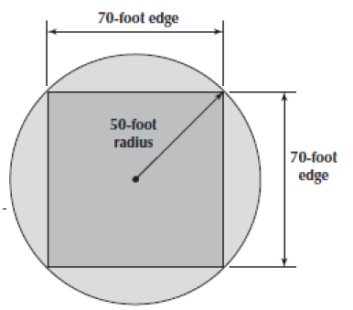
Designing User Access with Wireless Ethernet Continued
An AP with an omnidirectional antenna broadcasts in all directions
Typical design limit is a 50-foot-radius circle
Many wireless designers use a radius of 50 feet when planning traditional office environments
Most designers plan wireless LANs using 50- to 75-foot squares, depending on the construction of the building

Slide 52
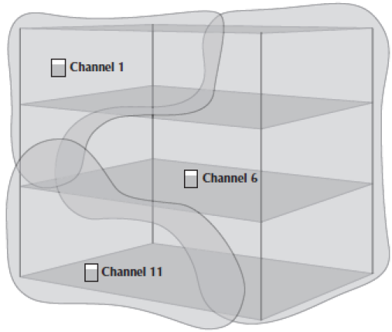
Multistory Buildings
Design becomes more difficult in a multistory building
Signals from the APs travel up and down as well as in all horizontal directions
The design must ensure that APs on different floors do not interfere with one another.
Floors are usually thicker than walls and signals travel further horizontally than vertically, making design a bit more difficult.

Slide 53
Guest Network
Most wireless LAN APs offer the ability to provide two separate wireless networks
The primary network is secured by a password that is entered when you first connect to the network
The second network is a guest network that is secured by a separate password that is entered on a Web page when you first connect to the network
This network is not secure
This network is typically used by guests who need temporary access

Slide 54
Designing the e-Commerce Edge
The e-commerce edge contains the servers that are designed to serve data to customers and suppliers
The e-commerce edge is essentially a smaller, specialized version of the data center
The e-commerce edge often has different security requirements than the servers in the data center

Slide 55
Designing the SOHO Environment
Small-office, home-office (SOHO) environments can be small versions of enterprise designs, or can take a very different approach
Installing cables for wired Ethernet is expensive, so most SOHO designs use wireless Ethernet
Sometimes a house is big enough that one WAP won’t cover the entire building and may use powerline networking

Slide 56
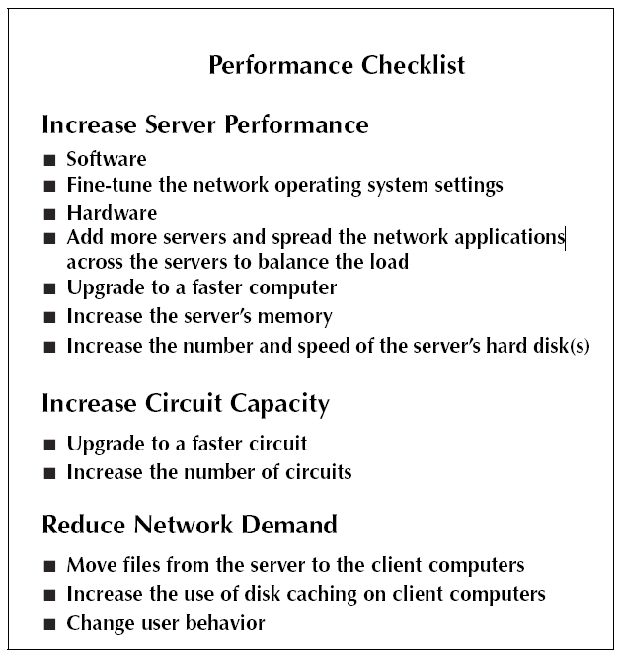
Performance Checklist

Slide 57
Improving Circuit Capacity
Improving the capacity of a circuit means increasing the volume of simultaneous messages the circuit can transmit.
One obvious approach is simply to buy a bigger circuit.
Another approach is to segment the network.
If there is more traffic on a LAN than it can handle, you can divide the LAN into several smaller segments
In a wired LAN, this means adding one of more new switches
In a wireless LAN, this means adding more APs that operate on different channels.

Slide 58
Reducing Network Demand
One way to reduce network demand is to move files to client computers
Another way to reduce demand is to shift it from wired networks to wireless networks, or vice versa.
Network performance can be improved by attempting to move user demands from peak times to off-peak times
Finding one application that places a large demand on the network and moving it can have a significant impact.

Slide 59
Server Virtualization
Server virtualization is the process of creating several logically separate servers on the same physical computer.
The virtual servers run on the same physical computer but appear completely separate to the network.
Server virtualization enables firms to save money by reducing the number of physical servers they buy and operate, while still providing all the benefits of having logically separate devices and operating systems.
Some operating systems enable virtualization natively.
In other cases, special-purpose virtualization software is installed.

Slide 60
Storage Area Network
A storage area network (SAN) is a LAN devoted solely to data storage
When the amount of data to be stored exceeds the practical limits of servers, the SAN plays a critical role.
The SAN has a set of high-speed storage devices and servers that are networked together using a very high-speed network.
The devices may be network-attached storage (NAS) devices
A NAS is not a general-purpose computer
It has a small processor and a large amount of disk storage and is designed solely to respond to requests for files and data

